Slide 1

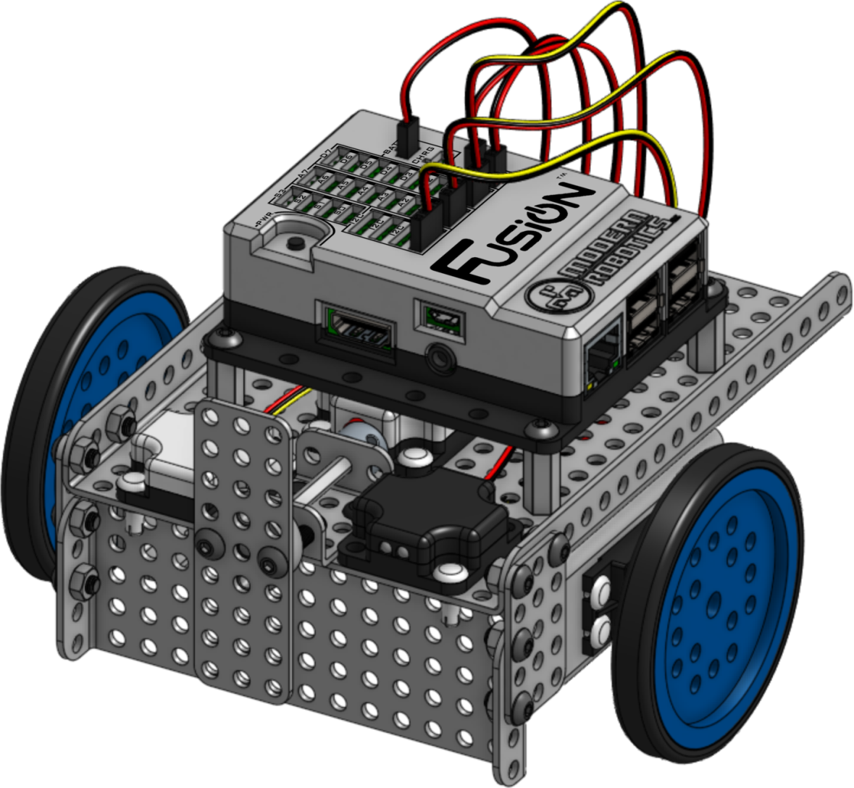

Modifying the Legacy BaseKit
to add the
Planetary Exploration Pack
Version 1.2
Boxlight Robotics

Slide 2
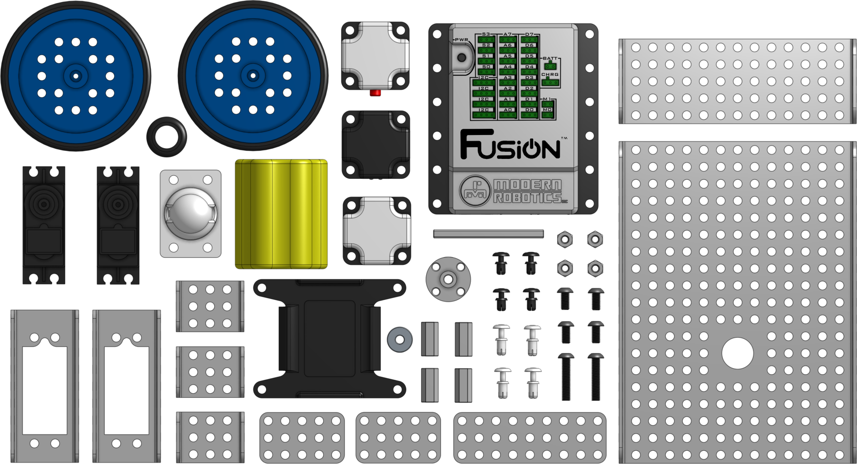
Legacy BaseKit Update Instructions
These instructions describe how to modify the original Robotics/MyBot Base Kit to accept the Planetary Exploration Sensor Pack.
Please see the information on the next page to help identify if your robot was built using the original Instructions.
Copyright 2018-2020, Boxlight Robotics, All Rights Reserved
No part of this document may be copied, published in print or shared online or otherwise publicly released without the express written consent of Boxlight Robotics.
Note: Specifications listed are subject to change without notice.

Slide 3
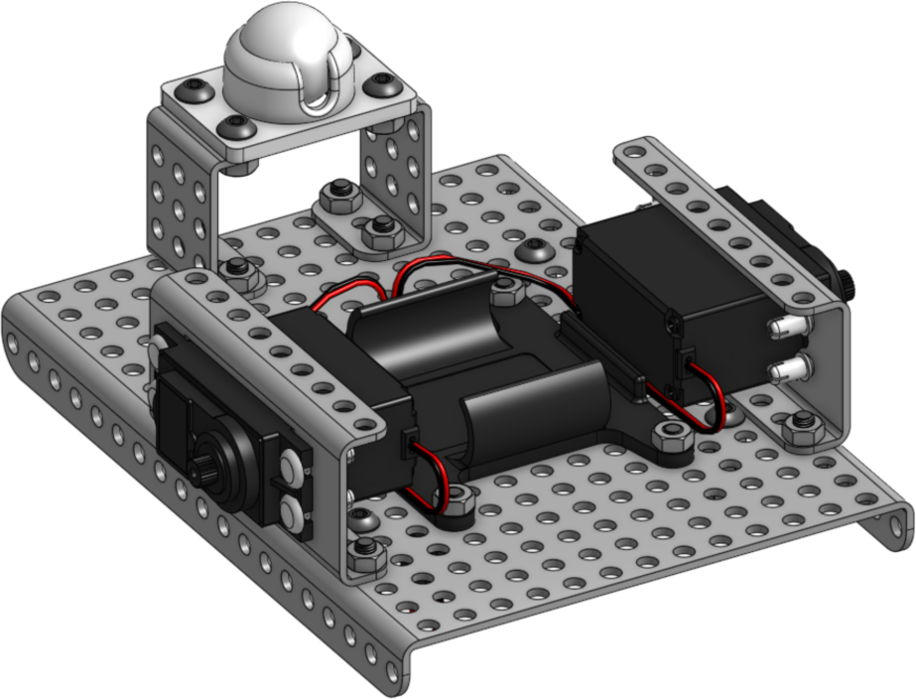
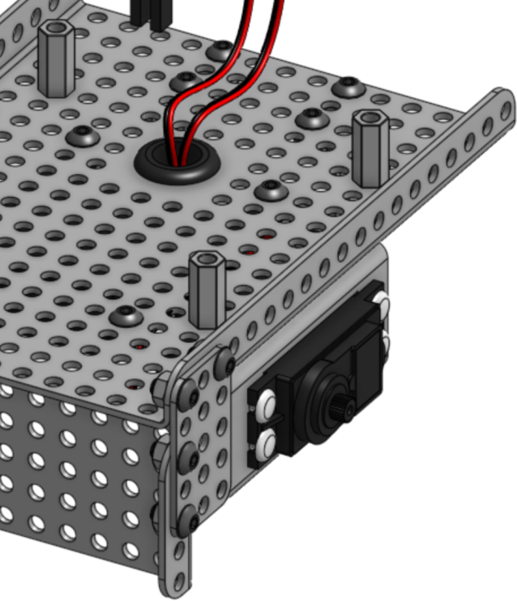
Legacy Build Identification Guide
The original build can be identified through several clues:
The motors are attached to the mounting plates using white plastic fasteners.
The motor mounting plates are attached to the robot’s base plate using screws and nuts.
The motor mounting brackets touch the 3x5 plates that are used to mount the front bumper (or cow-catcher).
1) Motor attached with
white plastic fasteners
2) Motor mounting plates attached with screws and nuts
3) No ‘gap’ between motor mounts and 3x5 plates
If there is not gap of about 8mm between the motor mounting plates and the 3x5 plates, you will need to move the motors back by one mounting hole as shown following the Illustrated List of Components.

Slide 4
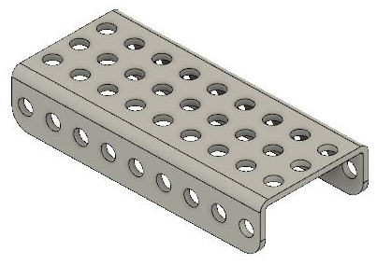
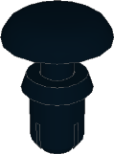
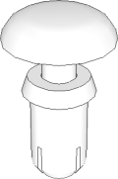
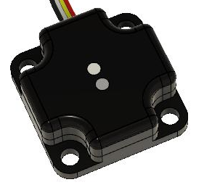
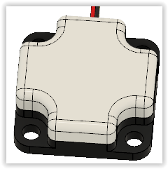
Illustrated List of Components Needed
Extra components from the original Base Kit Build |  | New components in the Planetary Exploration Pack
x2 11-6001 Quick Connect Short |  | X1 06-0009 9 Hole C Shaped Beam
x4 11-6002 Quick Connect Medium |  | X1 45-2018 Color Sensor
 |  | X1 45-2020 Magnet Sensor

Slide 5

1
Move the Motors Back by One Hole
In order to allow the new sensors to be mounted, it is necessary to move the motors and their mounting plates back by one hole.
This creates a gap between the motor mounts and the 3x5 plates used to mount the front bumper (or cow-catcher).
Move the motor mounting plates towards the back of the robot by ONE hole, creating an 8mm wide gap here.
For each motor mounting plate, loosen and remove the screws, carefully slide the unit back by one hole, and reattach using the screws and nuts.
When complete, you will have four (4) empty holes in front of each motor unit.
Move back one hole so that the motors are mounted with four (4) empty holes in front of them.

Slide 6

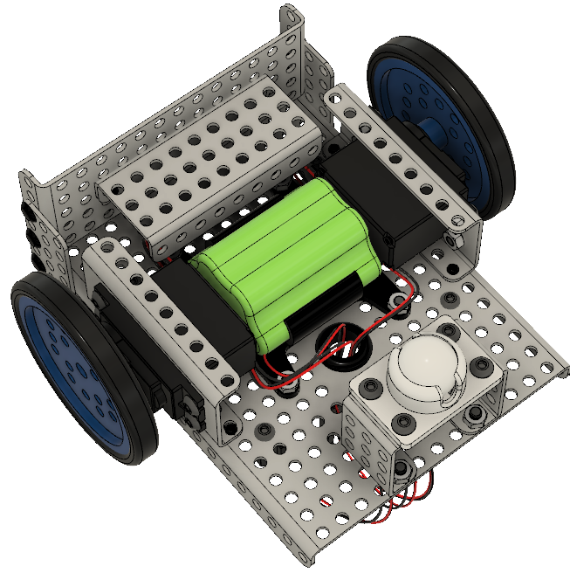

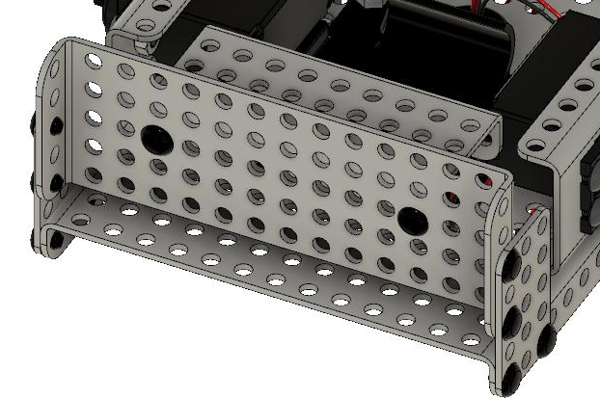
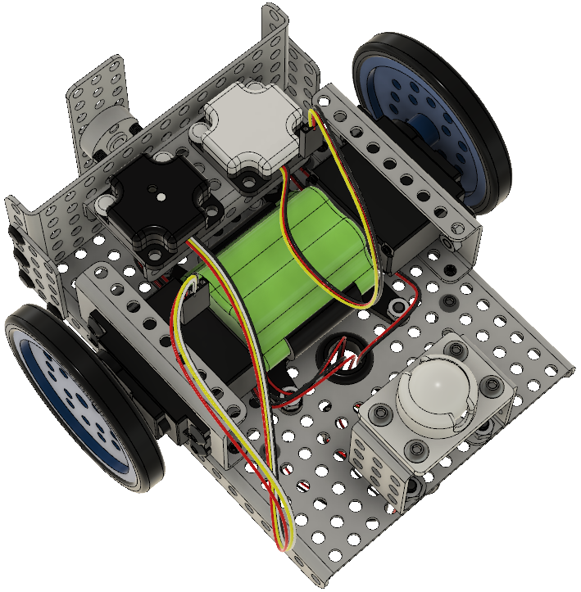

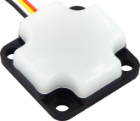
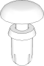
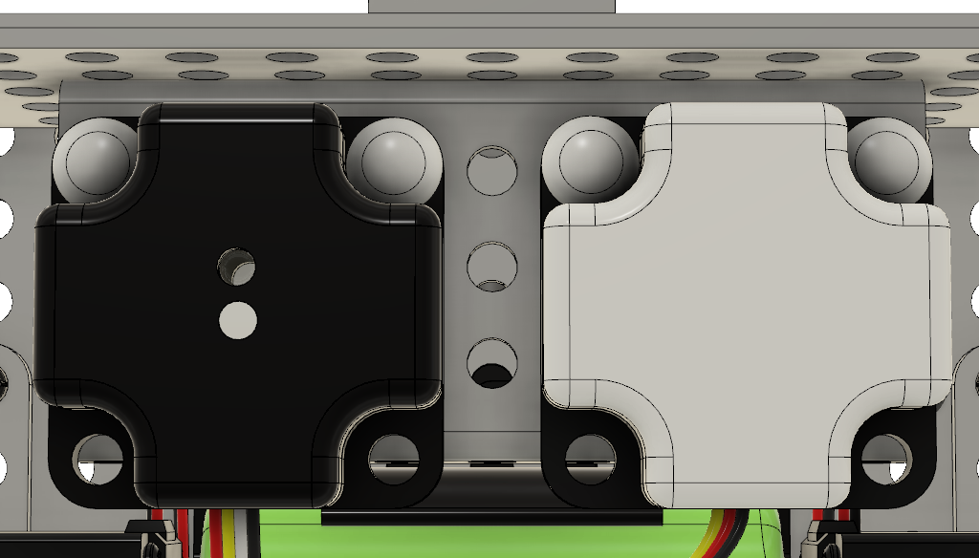
2
x1
x2
3
x1
x1 (Magnetic Field Sensor)
x4

Slide 7
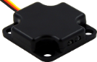

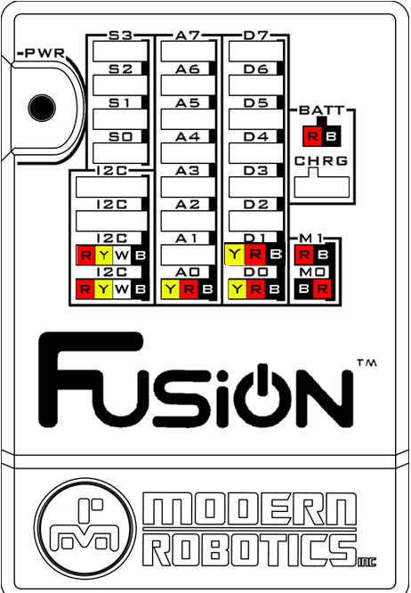
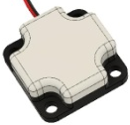
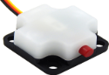

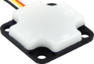
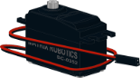


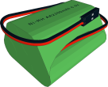
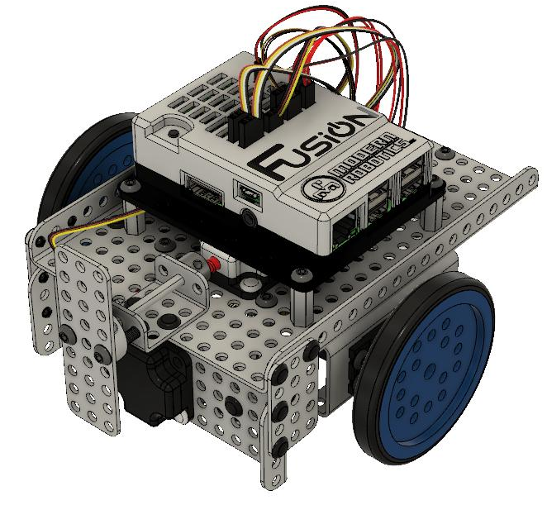
4 – Wiring
Optical Distance Sensor | → | A0
Magnetic Field Sensor | → | A1
Touch Sensor | → | D0
Color Sensor | → | I2C
Integrating Gyro | → | I2C
Left Motor | → | M1
Right Motor | → | M0
Battery | → | BATT
M0
M1

